Slide 1



Source Code Management
Automation Server
Artifact Repository
Manage Source
Build and Test
Manage Release

Slide 2
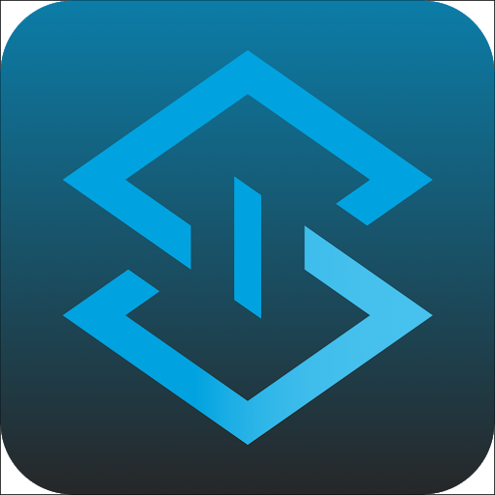



1 - Develop, Local Testing
Mule App version x.x.x-SNAPSHOT
pom.xml

Slide 3
2 –Push to develop branch
1 - Develop, Local Testing
Mule App version x.x.x-SNAPSHOT
pom.xml

Slide 4
2 –Push to develop branch
1 - Develop, Local Testing
Mule App version x.x.x-SNAPSHOT
3 – Start Building
pom.xml

Slide 5


START PIPELINE
Checkout SCM

Slide 6
1 - Get source and pom.xml info
Checkout SCM

Slide 7
1 – Check dependencies
Checkout SCM
Build and Test

Slide 8
1 – Check dependencies
2 – Build Project
Checkout SCM
Build and Test

Slide 9

1 – Check dependencies
2 – Build Project
3 – Test (Munit)
Checkout SCM
Build and Test

Slide 10
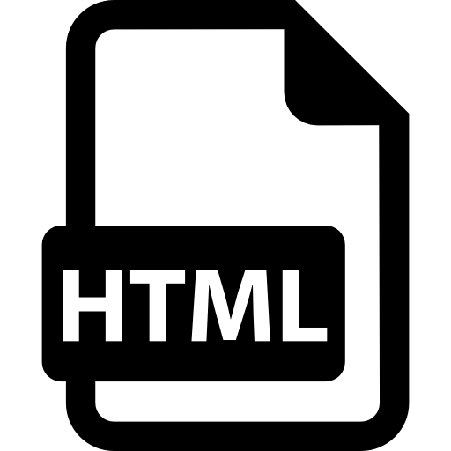
1 – Check dependencies
2 – Build Project
3 – Test (Munit)
4 – Publish Coverage Report
Checkout SCM
Build and Test

Slide 11
1 - Change version from x.-SNAPSHOT to x.y.z
Checkout SCM
Build and Test
Release Version

Slide 12

1 - Change version from x.-SNAPSHOT to x.y.z
2 – Push a release tag to SCM
Checkout SCM
Build and Test
Release Version

Slide 13
1 - Change version from x.-SNAPSHOT to x.y.z
2 – Push a release tag to SCM
3 – Create a new SNAPSHOT version and push to SCM
Checkout SCM
Build and Test
Release Version
ci-cd-0.0.4-SNAPSHOT

Slide 14

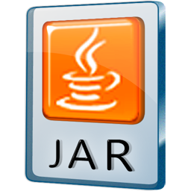
1 - Change version from x.-SNAPSHOT to x.y.z
2 – Push a release tag to SCM
3 – Create a new SNAPSHOT version and push to SCM
4 - Build the Artifact
Checkout SCM
Build and Test
Release Version

Slide 15
1 - Change version from x.-SNAPSHOT to x.y.z
2 – Push a release tag to SCM
3 – Create a new SNAPSHOT version and push to SCM
4 - Build the Artifact
5 – Deploy the Release to Nexus
Checkout SCM
Build and Test
Release Version
Mule Application

Slide 16
1 – Copy the Release Artifact from Nexus Releases Repository
Checkout SCM
Build and Test
Release Version
Download Artifact
Mule Application

Slide 17


1 – Get Local Copy of Artifact
Checkout SCM
Build and Test
Release Version
Download Artifact
Deploy Mule App

Slide 18
1 – Get Local Copy of Artifact
2 – Deploy Mule App to Cloudhub (Runtime Manager)
Checkout SCM
Build and Test
Release Version
Download Artifact
Deploy Mule App

Slide 19
Pipeline END
Checkout SCM
Build and Test
Release Version
Download Artifact
Deploy Mule App

Slide 20
Overview
Checkout SCM
Build and Test
Release Version
Download Artifact
Deploy Mule App

Slide 21
1–Push to Develop
2-Trigger pipeline
3-Checkout SNAPSHOT
4-Build and MUnit Test
5-Push Release and new SNAPSHOT
6-Deploy Artifact
7-Copy Artifact
8-Deploy to Mulesoft
Checkout SCM
Build and Test
Release Version
Download Artifact
Deploy Mule App
4
3
5
6
7
8
2
1

